Slide 3
(Pre-adaptation, R0 >> 1)
Number of mutations to adaptation
†
Spillover rate
R0 of first infection
Introduction (from reservoir)
Evolution during stuttering chains of transmission in humans
Incipient
epidemic
R0 increasing
R0 = 1
Extinction
Emergence

Slide 4
Introduction
(from reservoir)
Transmission in
human population
†
†
†
†
†
†
†
Infections by:
†
4 mutations away from R0 > 1
3 mutations away from R0 > 1
2 mutations away from R0 > 1
1 mutations away from R0 > 1
R0 > 1
†
†
Emergence

Slide 5
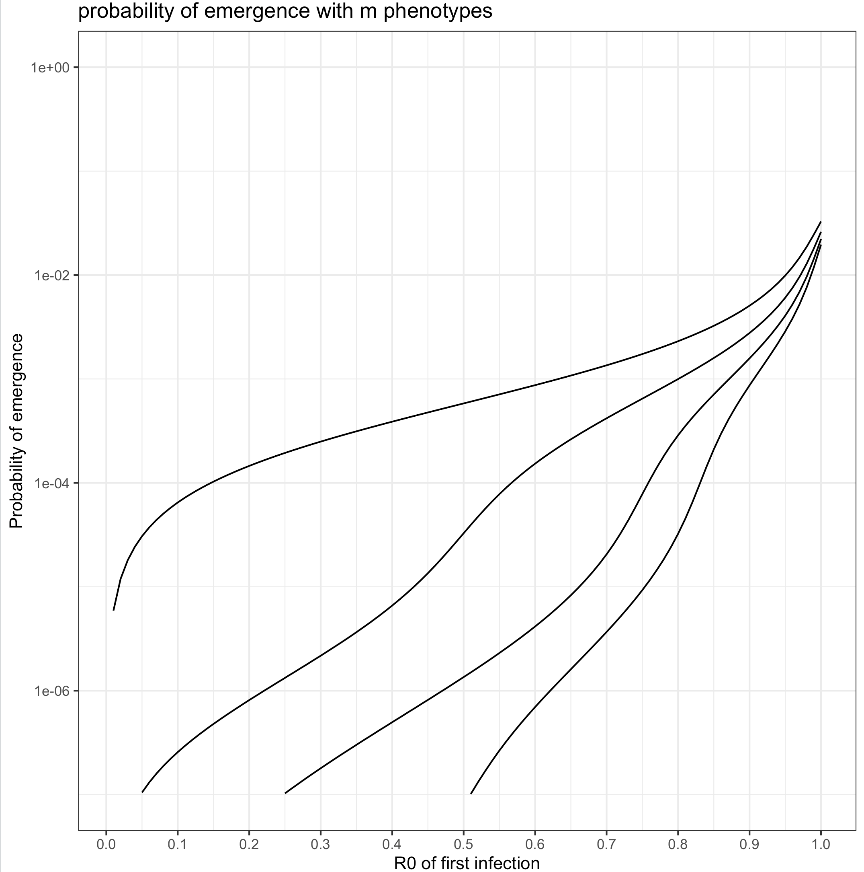
m=3
R0 of introduced pathogen
0
0.5
1
R0 of introduced pathogen
m = 2
0
0.5
1
m=5
m = 3
Regardless of R₀ first infection, the lineage must accumulate m-1 mutations.
The first infection is always of type 1, and 𝚫R₀ decreases with R₀ of first infection.
R0 of introduced pathogen
m = 4
m = 5
0
0.5
1
R0 of introduced pathogen
0
0.5
1

Slide 6
4 mutations
away
3 mutations
away
2 mutations
away
1 mutations
away
Human-adapted
The R₀ of the first infection indicates the number of mutations left before adaptation (i.e, the starting type)
𝚫R₀ is the same regardless of initial R₀.
𝚫R₀
0
𝚫R₀
2𝚫R₀
4𝚫R₀
1
R₀
Notes:
Gain of function assumption (Title)
Think in terms of delta R0 for reimagining

Slide 7
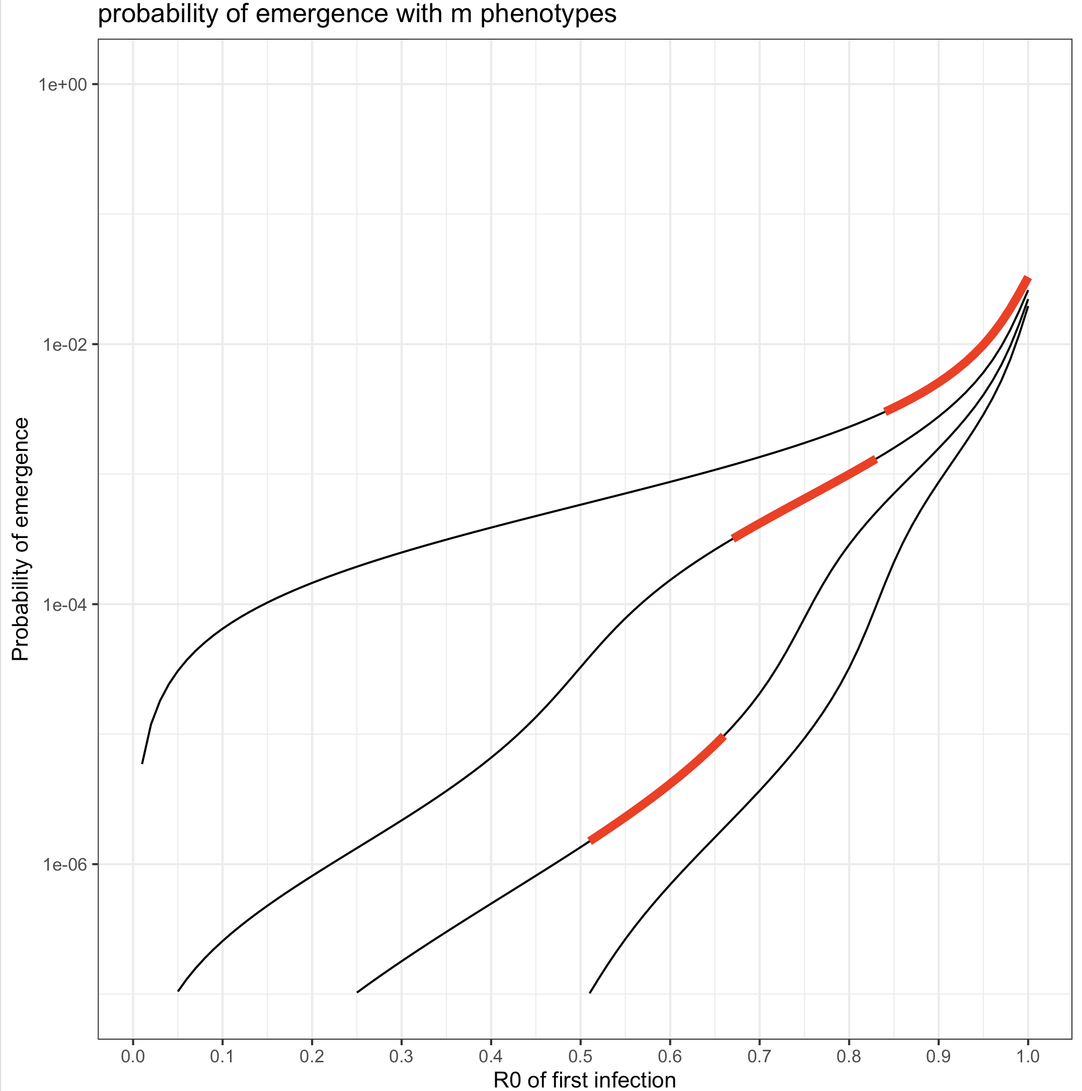
m=2
m=3
m=4
m=5

Slide 8
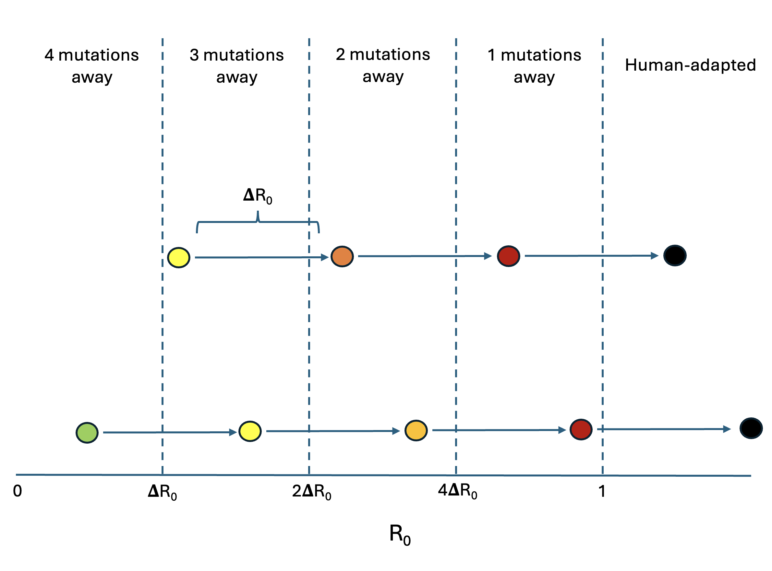
1 mutation away
2 mutations away
3 mutations away

Slide 9
𝚫P_{emergence}
R₀(1-fv)

Slide 10
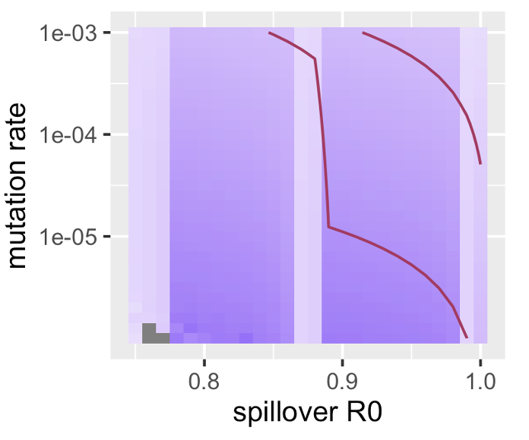
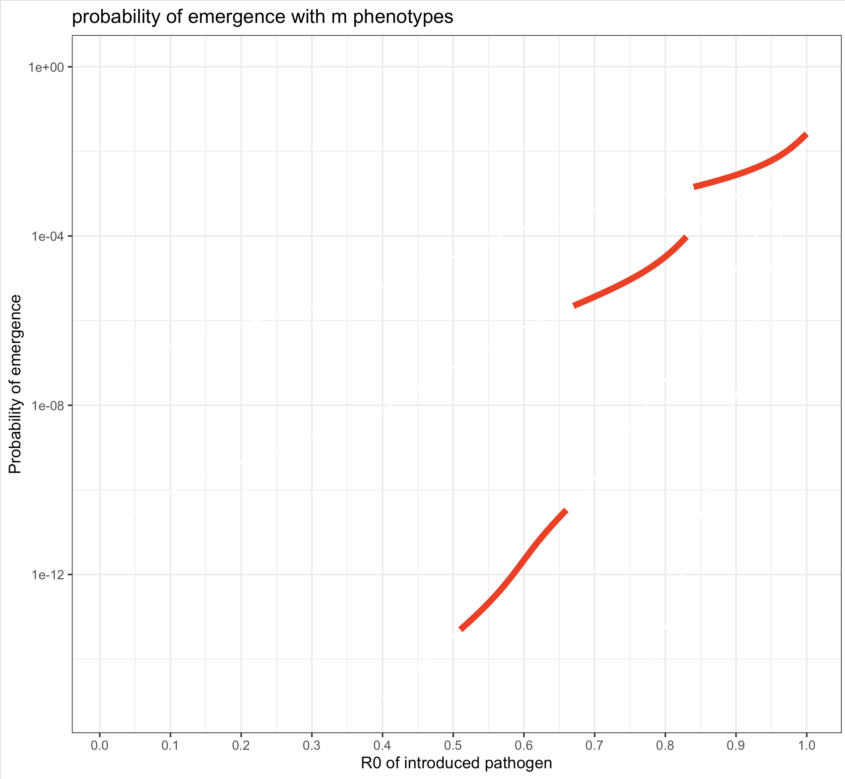
fv
𝚫P_{emergence}
Caveats: assuming VE_{SI} = 1
R₀(1-fv)

Slide 11
Probability of emergence depends on: 1) the number of mutations required to adapt, 2) the mutation rate, 3) the R0 of the first spillover infection.

Slide 12
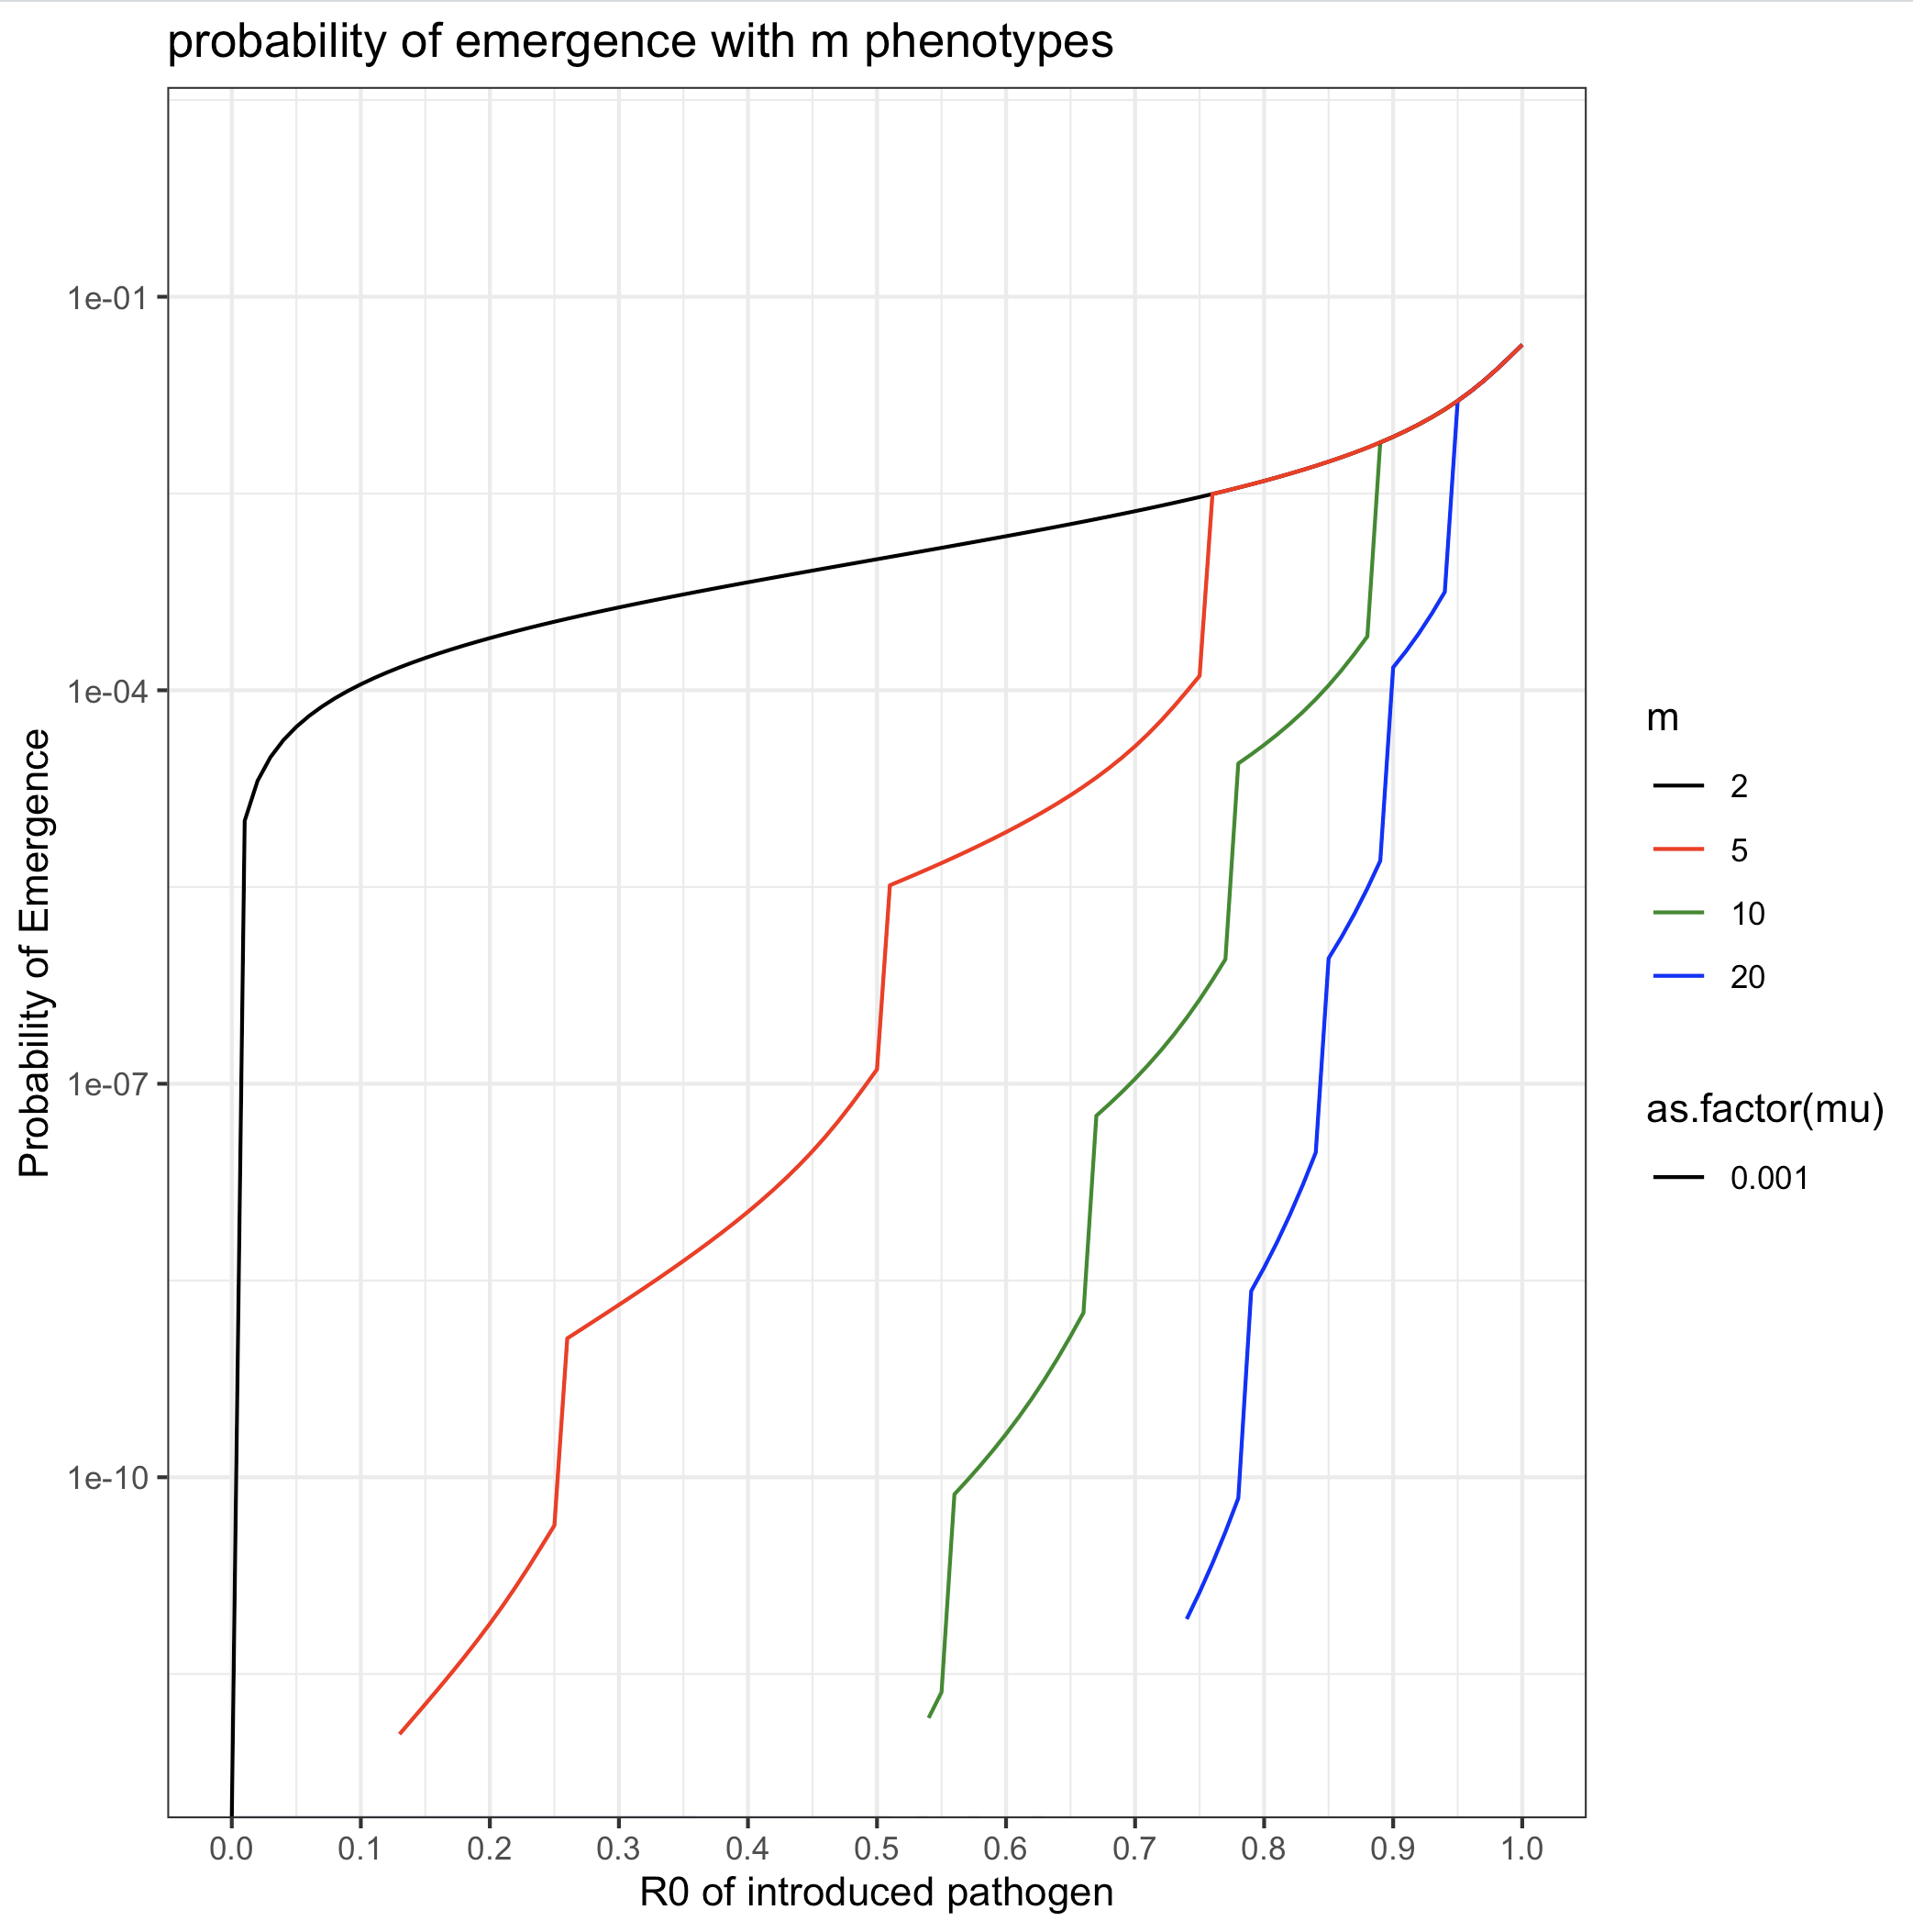
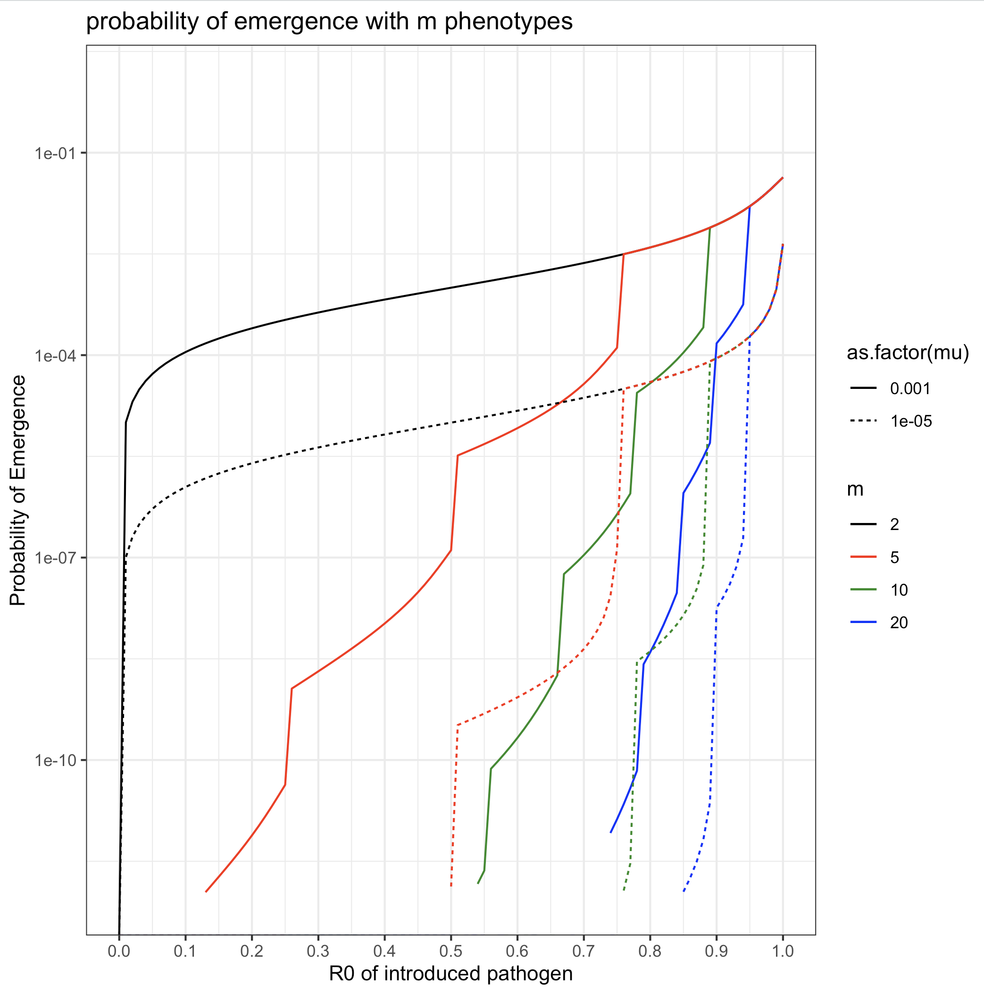
Notes:
Thicker dashed lines, mu, differentiate the colors more,
Step size delta R0 instead of m

Slide 13
Probability of emergence and fold change in probability of emergence as proportion vaccinated increases

Slide 14
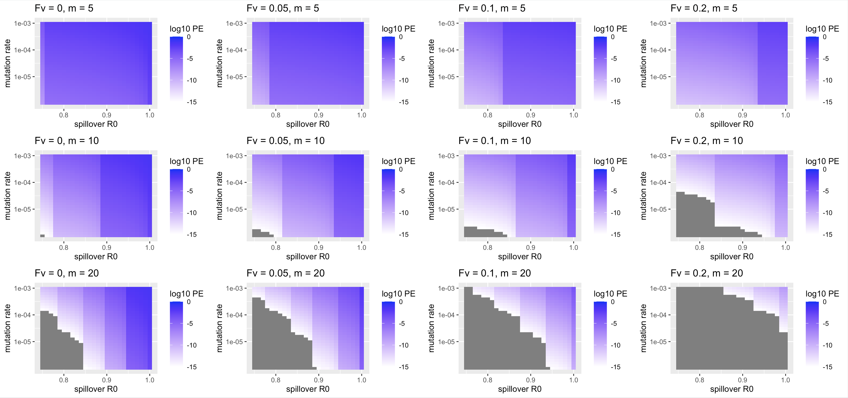

Slide 15
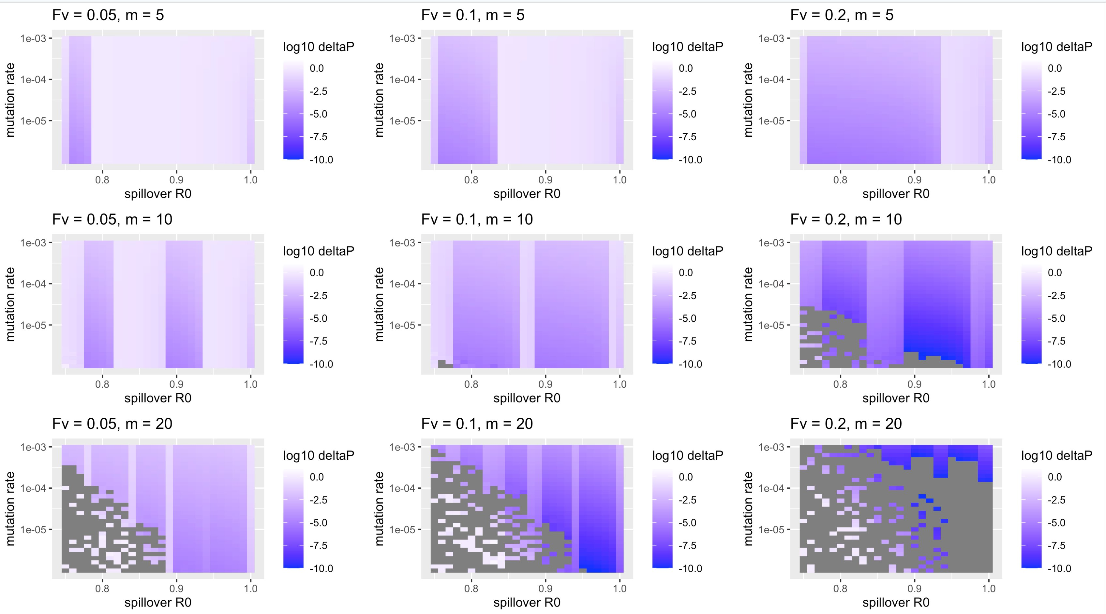
Notes:
Put these in the supplement and explanation at end

Slide 16
Time to emergence, change in time to emergence, and parameter regimes where vaccination could prevent spillover as proportion vaccinated increases

Slide 17
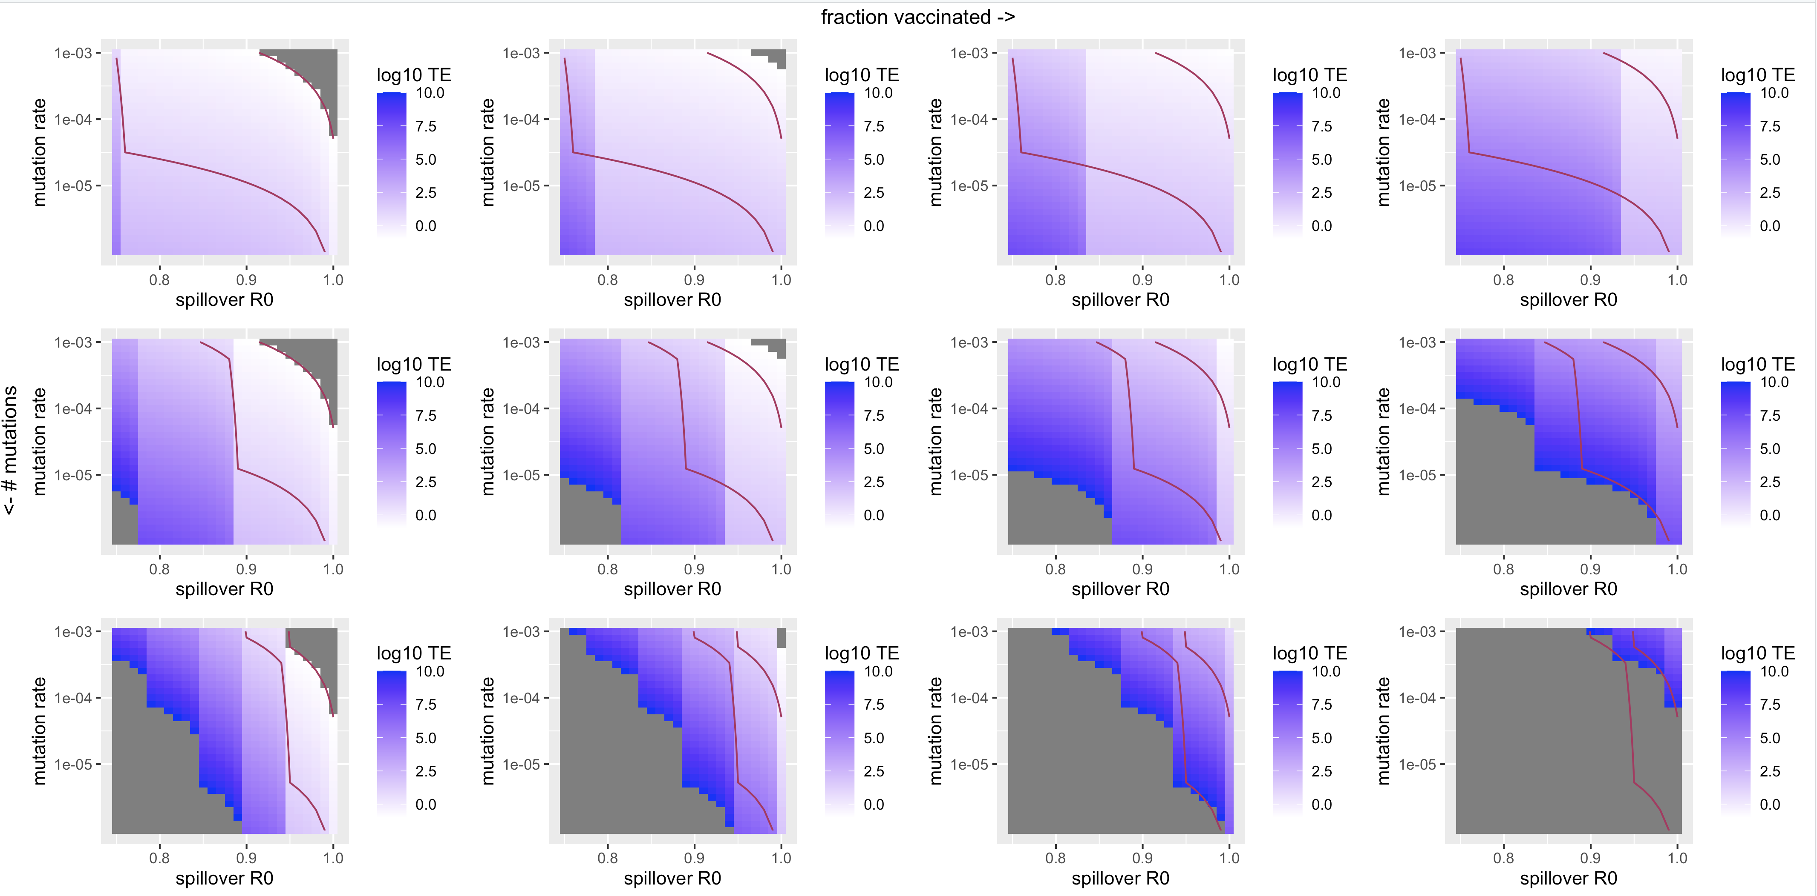

Slide 18
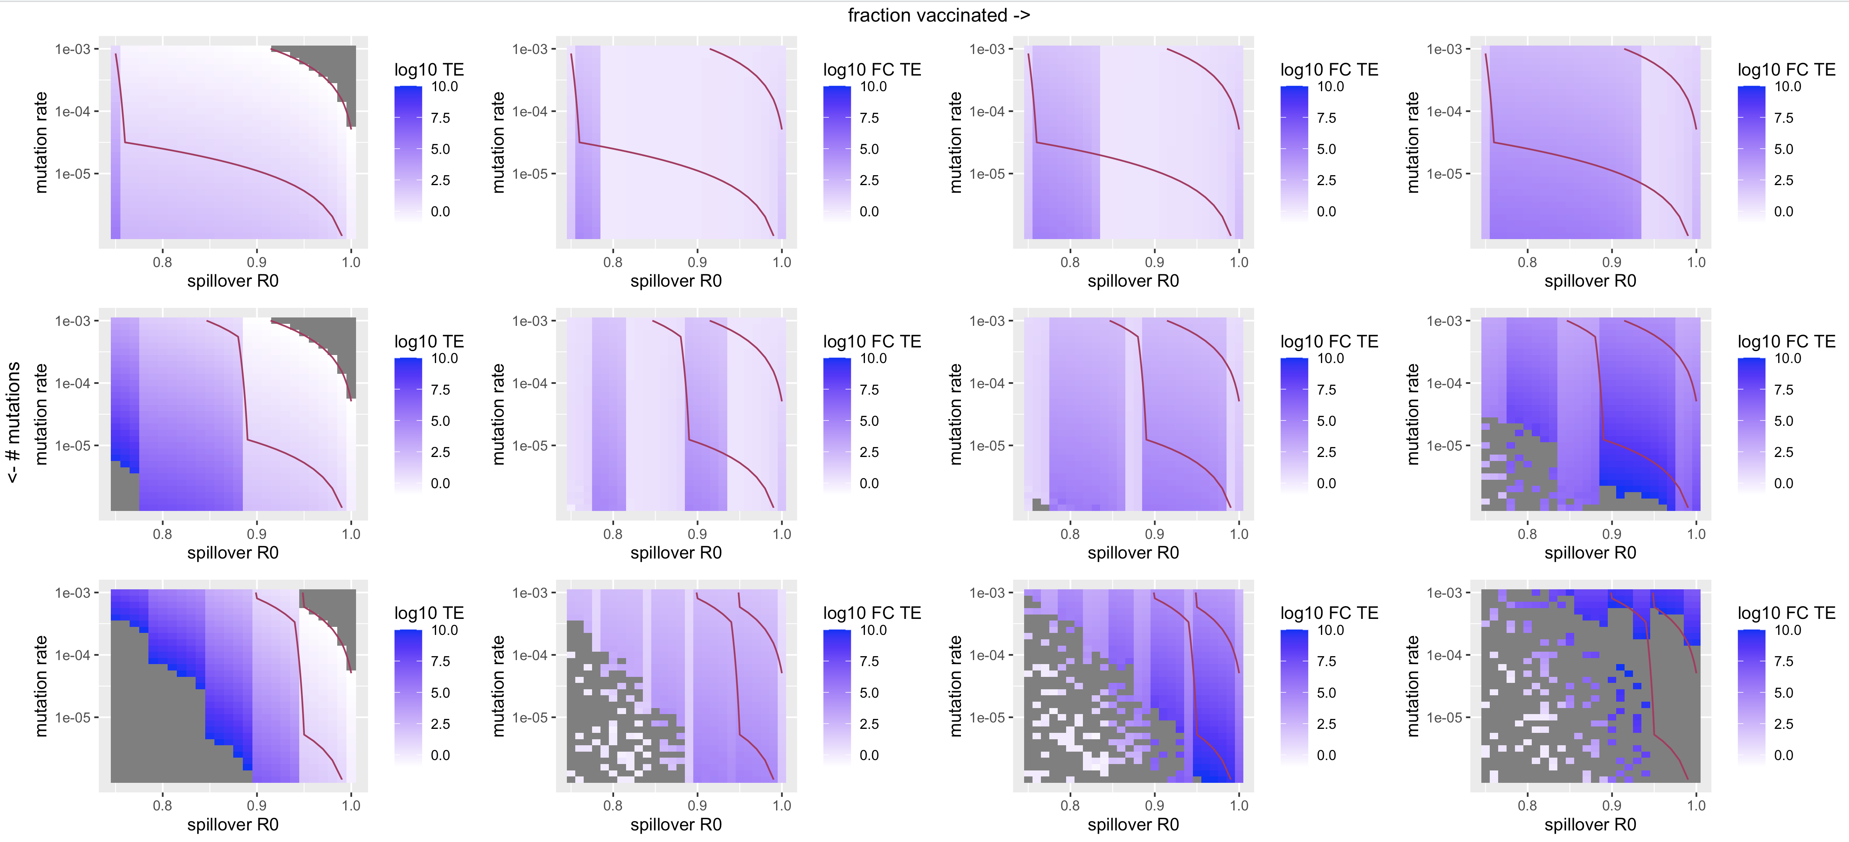
TE Pre vaccination
Fold reduction in TE in vaccinated population
Notes:
Paste fractions and # mutations
Put these in the supplement

Slide 19
